Slide 1


CCSA EU External Affairs Task Subgroup
28/01/2025

Slide 2

Housekeeping
Meeting is being recorded, slides and recording will be circulated with members
CCSA Competition Law Policy notice is attached to the meeting invite/available on the CCSA website
If you are not speaking, please mute your microphone
Please raise your hand if you wish to comment, you will be invited to come off of mute, if you can also turn on your camera
Please also pose any comments in the chat and these will be picked up by the secretariat
Any volunteers for group convenors?
Secretariate update
© CCSA Confidential information |
2

Slide 3
Agenda
 | Time | Topic | Speaker
1. | 15:30 | Intro | CCSA Secretariat
2. | 15:35 | Clean Industrial Deal – CCSA actions | Ariadna Lungulescu, CCSA, Charles-Albert Bareth, CCSA
3. | 15:50 | CCSA EU Conference 2025: Draft agenda | Francesco D’Apolito, CCSA
4. | 16:05 | CCSA Events Q1/Q2 2025 | Francesco D’Apolito, CCSA Ariadna Lungulescu, CCSA
5. | 16:20 | Media Partnerships | Francesco D’Apolito, CCSA
6. | 16:25 | AOB & Conclusions | CCSA Secretariat
© CCSA Confidential information |
3

Slide 4
Clean Industrial Deal – CCSA actions
CCSA Secretariat

Slide 5
What We Know
Publication expected on 26 February (possibly delayed by two weeks), alongside Competitiveness Compass and Omnibus Package
Will consist of six pillars: energy security and energy prices, finance, recycling and critical raw materials, labour and skills, lead markets and global measures.
What may be included:
  Simplification – publication of omnibus package;
  Clean quotas – creating demand for low-carbon products;
  Affordable green energy – Commissioner Ribera stated that she expects energy prices to fall;
  Investment – encouraging private investment alongside public funding;
  Social issues – taking into account regional development and skills;
  External dimension – ensuring a level playing field for European companies in the face of international competition.
© CCSA Confidential information |
5

Slide 6
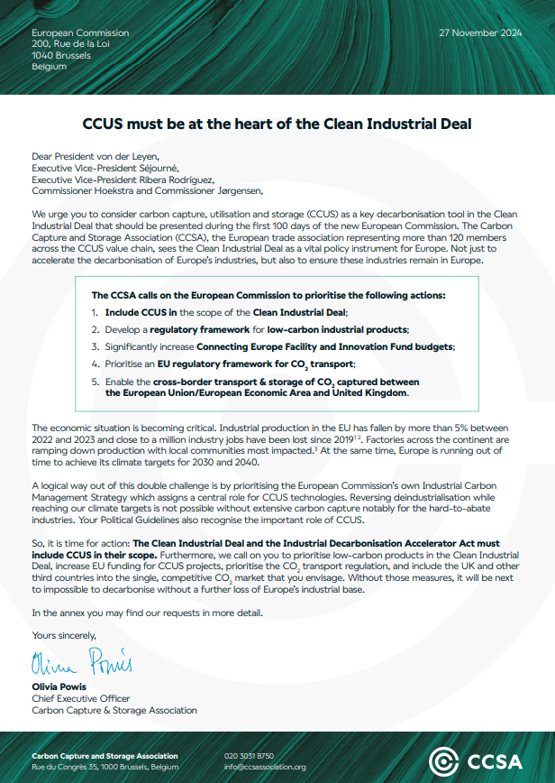
Next Steps
CCSA CID Letter – 27 November 2024
Include CCUS in the scope of the Clean Industrial Deal; - TBD
Develop a regulatory framework for low-carbon industrial products; - should be included.
Significantly increase Connecting Europe Facility and Innovation Fund budgets; - no direct reference, but increasing funding and private investments should be included.
Prioritise an EU regulatory framework for CO2 transport; - TBD
Enable the cross-border transport & storage of CO2 captured between the European Union/European Economic Area and United Kingdom. - TBD
Euractiv partnership – one article on what CCSA expects from the CID (w/c 27 Jan), and an op-ed reacting to it shortly after publication.
Joint letter with CATF, Bellona and other signatories – ‘’Open Letter Supporting CCS in the Clean Industrial Deal’’
Other actions?
© CCSA Confidential information |
6

Slide 7
CCSA EU Conference 2025: Draft agenda
CCSA Secretariat

Slide 8



CCSA EU Conference 2025 | At a glance
Event Details:
Date: Wednesday, 14 May 2025
Venue: Cardo Hotel
200+ attendees expected
20+ speakers
Themes include:
The Future of CCUS in the EU
Creating a Viable Market for CCUS Projects, Funding schemes
Public Perception of CCUS
CO₂ Transport Regulatory Package
CCUS Role in the Industrial
Decarbonisation Process,
CO₂ Cross-border Frameworks,
ETS, CBAM
CCSA EU Conference 2025
Brussels
14 May 2025
© CCSA Confidential information |
8

Slide 9
Session | Description
Keynote | Keynote speeches by a representative of the CCSA and European Commission (Invite sent to Commissioner Hoekstra).
Rebuilding Europe's industrial base: CCUS in the CID | As the European Commission pushes to rebuild EU's industry, CCUS technologies must be at the heart of the EU's decarbonised industry. CCUS offers a cost-efficient pathway to significantly reduce carbon footprints in various sectors like hard-to-abate industrial processes, including cement, lime, steel, chemicals, waste-to-energy, hydrogen production or power generation. The Clean Industrial Deal must reflect the key role of CCUS by investing into CO2 transport and helping to facilitate FIDs on CCUS projects across the EU. Join this session to discuss the critical role of CCUS in the Clean Industrial Deal.
45 min Break
Presentation - State of the CCUS market in Europe (TBC)
Unlocking Europe's CO₂ Storage Potential: barriers and opportunities | The Net-Zero Industry Act sets out an injection target of 50Mt of CO2 per year until 2030 - but to meet the Green Deal's 2040 emission reduction target, it is estimated that the EU will need to inject five times as much carbon dioxide. Therefore, unlocking storage capacities is key. This panel will discuss storage capacities across the EU, partnering with third party countries, and the long-term view of CCS.
Rolling out CO2 transport infrastructure across Europe | CO2 transport infrastructure will play a key role in successfully deploying CCUS technologies. Accelerating the rollout of pipeline and ship infrastructure, as well as building a strong business case through funding and de-risking, is key to ensuring industry access to geological storage across Europe. This panel will gather experts from the sector to examine the potential of existing and future projects, as well as the impact of regulation and funding.
© CCSA Confidential information |
9

Slide 10
Session | Description
Lunch Break (1:15h)
Sponsored presentation (topic tbc)
Presentation: CCSA report - ‘’Accelerating a Europe-wide CO2 Storage Market’’
CDR market ready for lift-off? | Earlier deployment and increased investment in industrial carbon removal technologies are necessary for the EU to achieve a 90% emission reduction by 2040 and carbon neutrality by 2050. Join our discussion with CDR experts as we explore the required policy framework for developing a comprehensive CDR market in the EU, the effectiveness of the Carbon Removal Certification Framework in incentivising the development of permanent carbon removal technologies, and the potential integration of CDR into the EU ETS.
30 min break
Sponsored presentation (topic tbc)
Use it or store it - development of CCU use cases and policies | From e-fuels to agriculture, construction and the food and beverage industry, captured carbon can have a myriad of uses. Replacing 'virgin' CO2 with captured carbon cross a range of industries must go hand-in-hand with storage of captured carbon. Join this panel to explore the uses of captured carbon, and discuss the policies needed to develop a market for CCU.
Networking Drinks
© CCSA Confidential information |
10

Slide 11
CCSA Events Q1/Q2 2025
CCSA Secretariat

Slide 12

External Affairs Planning 2025
Activities:
CCSA Webinar Series:
  4 February – Accelerating a Europe-wide CO2 storage market – Confirmed
  3-7 March – CCU – Date/Topic TBC
  31 March-4 April – CDR in ETS – Date TBC
Workshop on CO₂ transport with European Commission (DG ENER) – Confirmed
  12 March, 10:30-12:30 CET
© CCSA Confidential information |
12

Slide 13
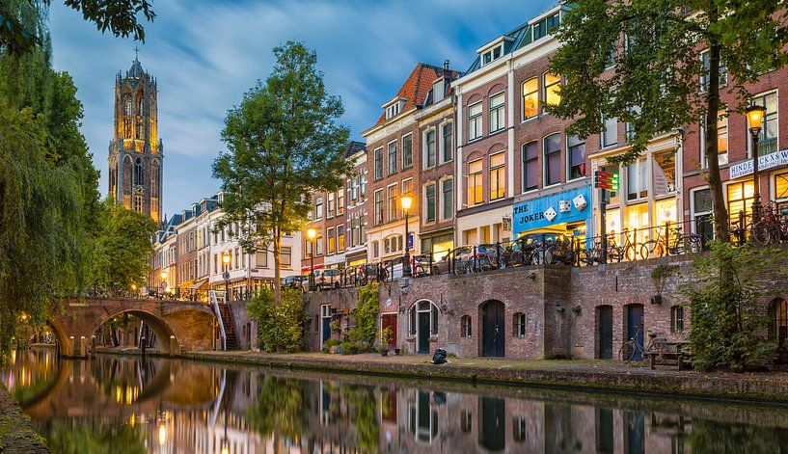
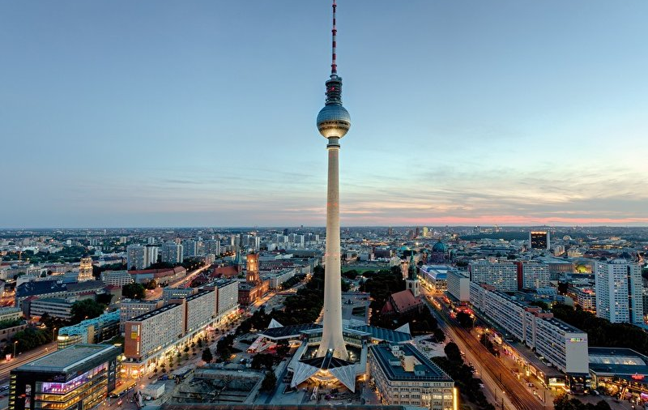
External Affairs Planning 2025
Activities:
CCSA Country Spotlight Series: The Netherlands – Confirmed
  25 March
  Centraal Museum, Utrecht
CCSA EU Conference: 14 May 2025, Brussels – Confirmed
CCSA Country Spotlight Series: Germany – Date TBC
© CCSA Confidential information |
13

Slide 14

External Affairs Planning 2025
Potential activities:
EUSEW 2025 – 10-12 June 2025 - TBC
  Application for a 90-minute policy sessions sent
  Results by the end of February
  CCSA applied jointly with Gas Infrastructure Europe. Speakers from GCCSI, CEMBUREAU, CATF, and European Commission (tbc)
© CCSA Confidential information |
14

Slide 15
Media Partnerships
CCSA Secretariat

Slide 16


Media Partnerships
Euractiv – Energy, Environment & Transport Hub
8 months of sustained coverage on Euractiv.com (Jan – Aug 2025)
7 article and op-eds covering CCUS
Topics including CO₂ T&S, CID, CCS market
Permanent landing page (CCSA’s logo, link to website, short video)
Highlighting the agenda of the CCUS industry
FORESIGHT Climate and Energy
1 year partnership
2 opinion interviews (audio only, podcast-format)
© CCSA Confidential information |
16

Slide 17

AOB & Conclusions
Summary:
AOB
© CCSA Confidential information |
17

