Slide 1


CCSA Permitting & Planning Working Group (UK)
01/12/2025
14:00-15:15 (GMT)

Slide 2
House Keeping & Introductions
This meeting is being recorded
Slides and recording will be available for members after the meeting​
CCSA Competition Law Policy notice is attached to the meeting invite​
If you are not speaking, please mute your microphone​
Please raise your hand if you wish to comment, you will be invited to come off mute, if you can also turn on your camera​.
Please also pose any comments in the chat and these will be picked up by the secretariat​.
Introductions of any new members joining the call.

Slide 3

Agenda
 | Time | Topic | Speaker
1. | 14:00 [5 mins] | Introductions & CCSA competition law policy notice | Nicola Smith, SSE (Chair)
2. | 14:05 [15 mins] | Permitting & Planning Updates Consultations Cumulative Impacts Workshop EALs: Data Request & Updates | Despoina Tsimprikidou, CCSA
3. | 14:20 [20 mins] | Water Discussion Previous meeting follow-up Defra engagement & next steps | All
4. | 14:40 [30 mins] | Discussion: 2026 Permitting & Planning Priorities | All
5. | 15:10 [5 mins] | Conclusions and AOB | Nicola Smith, SSE (Chair)
© CCSA Confidential information |
3

Slide 4
Permitting & Planning Updates
Despoina Tsimprikidou, CCSA

Slide 5
Consultations
Organisation | Recently completed consultations (x9) | Date
DEFRA | Modernising environmental permitting for industry | 21 Oct
MHCLG | Streamlining infrastructure planning | 27 Oct
DESNZ | CCUS Future Network Strategy | 31 Oct
DESNZ | Evolution of economic regulation for CO2 Storage | 31 Oct
Organisation | Open consultations (x1) | Date
EA | Charge Proposal: Decarbonisation Readiness* | 6 Jan
MHCLG | Reforms to the statutory consultee system* | 13 Jan
DESNZ | Ensuring fair access to CO2 infrastructure | 6 Feb
EA | Reserving Water Abstraction Rights | 16 Feb
*minded to not respond
** for discussion
In 2025, the CCSA responded to:
Organisation | Overdue or expected consultations (x2) | Date
DESNZ | Non-Pipeline Transport | Nov
DSIT | Delivering the right policy and regulatory framework to support innovation, investment and competition | Dec
© CCSA Confidential information |
5
Notes:
List of all relevant to this group consultations that the CCSA has submitted responses to – as well as currently open and expected consultations
This year we have responded to….
Since our last meeting, we have responded to….
Notably: EPR: key points raised in the CCSA response: clarity for water abstraction licenses, solvent confidentiality, regulatory approach to risk management, regulator’s resources and capacity, we also supported the guidance for emerging techniques approach, but raised some concerns regarding the dynamic approach to BAT proposal for CCUS, the horizontal BAT proposal, and the outline permitting approach. Regarding proposals to regulate types of carbon capture that are currently not included within EPR, we supported this in principle as we did not receive any member input that would suggest otherwise.
In terms of ongoing consultations…..
In terms of upcoming consultations that this group might want to comment on….
Any questions or comments on this list of consultations?

Slide 6
EALs data request
Cumulative Impacts
EA are currently in the process of developing 11 new EALs for carbon capture.
However, there is insufficient toxicological data to proceed dossiers for: ethylmethylamine (CAS 624-78-2), ethylethanolamine (CAS 110-73-6), N-dimethylethylenediamine (CAS 108-00-9), 1-piperazineethanol (CAS 103-76-4), and 1,4-piperazinediethanol (CAS 122-96-3).
EA welcomes any relevant evidence from solvent manufacturers that may inform these toxicological assessment to avoid delays in the derivation of new EALs.
If you wish to respond to this data request, please provide your feedback to despoina.tsimprikidou@ccsassociation.org by Wednesday, 10 December.
  Any data received will be handled sensitively by the CCSA.
Dedicated workshops will take place tomorrow, 2 December.
Additional workshops will take place in February – calendar placeholders will be circulated shortly to those who have expressed interest.
To produce an industry position paper outlining options and recommendations to regulators.
Using Teesside as a case study.
Updates will be provided through this Working Group.
  Is there any input you would like us to consider?
© CCSA Confidential information |
6

Slide 7
Recent Publications
EA Emerging carbon capture technologies report
Explores environmental impacts of emerging carbon capture technologies
EA Cumulative air quality impacts report
Investigates the potential future impacts on air quality from net zero technologies in the Humber and Teesside industrial areas.
Decarbonisation Readiness Guidance
EA Chief Regulators Report
EA response to CCSA EAL feedback
Final Guidance for new or substantially refurbished combustion power plants – will apply to applications from 28 February 2026
Summarises performance of regulated areas for 2024-25, including progress achieved for CCUS
Will be circulated with meeting materials
Natural England Strategy
Sets out how Natural England will play a role in environmental improvement goals
Consultation response
Available here
Available here
Available here
Available here
© CCSA Confidential information |
7

Slide 8
Water Discussion
All

Slide 9
EA Consultation on Reserving Water Abstraction Rights
This consultation seeks views on two approaches to determine water abstraction license applications to:
reserve water abstraction rights for strategic water resources schemes
  granting an abstraction licence to a strategic water resources scheme in advance of its proposed start of operation
allocate reserved abstraction rights when there are competing demands for water
  If competing demands remain, introduce a hierarchy of use:
    Tier 2: non-PWS critical national infrastructure
    Tier 3: net zero activities such as CCUS
What future measures are needed to improve the allocation of water abstraction rights?
The consultation is open until 16 February.
If you have any views on this consultation, please contact Despoina.Tsimprikidou@ccsassociation.org
Please note that due to a high number of open consultations, the CCSA will respond to this consultation only if we receive member input.
What challenges could or risks could arise from implementing the proposed framework?
Does NOT consider water resource prioritisation.
© CCSA Confidential information |
9

Slide 10
National Framework for Water Resources 2025: Water for growth, nature and a resilient future
CCSA Planning and Permitting Working group 25 September 2025
Nicola Smith Head of Environment SSE Thermal

Slide 11
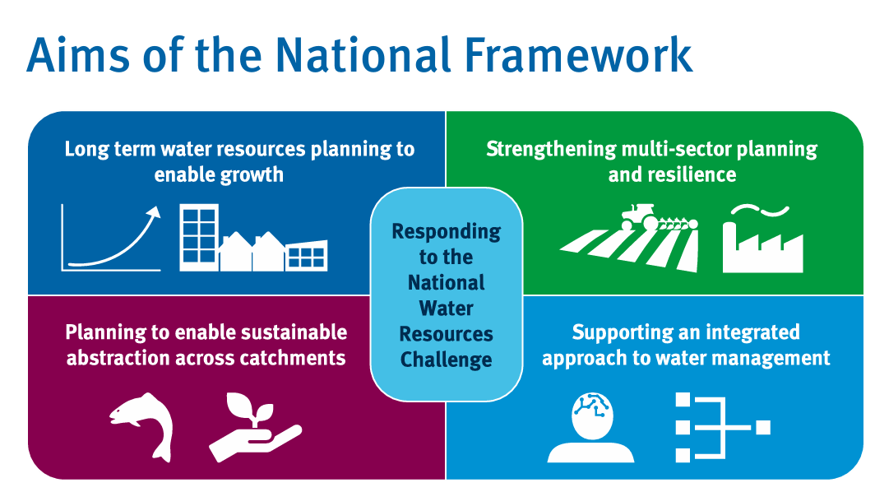

National Framework for Water Resources 2025: water for growth, nature and a resilient future –
Without action:
  5 billion litres/day shortfall for PWS by 2055
  1 billion litres/day shortfall for non-PWS by 2055, including water for energy security and agriculture
Growing pressure on water resources:
  threat to water supply to homes
  restricts economic growth
  damage resilience for energy supplies
  limit food production
  harm the environment
60% of deficit to be addressed through demand management and leakage reduction
Action required from government, regulators, regional groups, water companies, abstractor groups and water users across all sectors

Slide 12
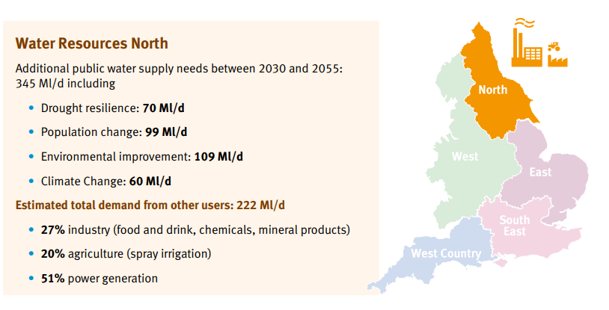
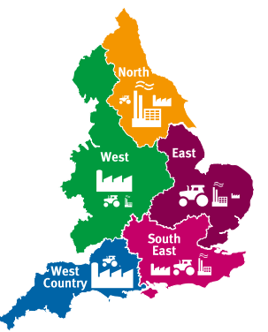
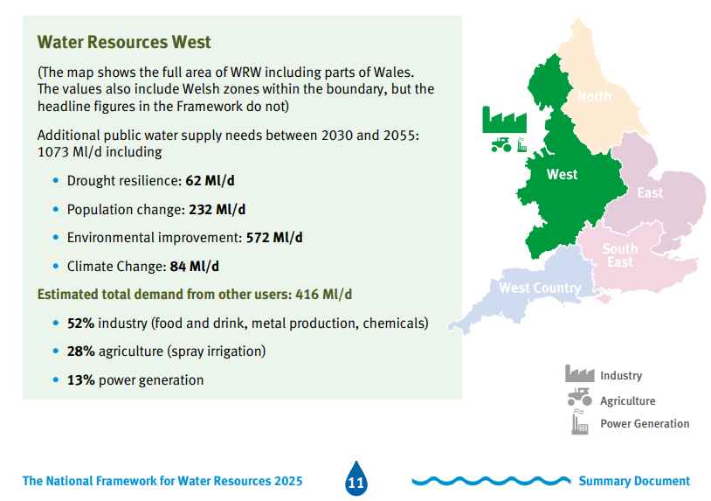
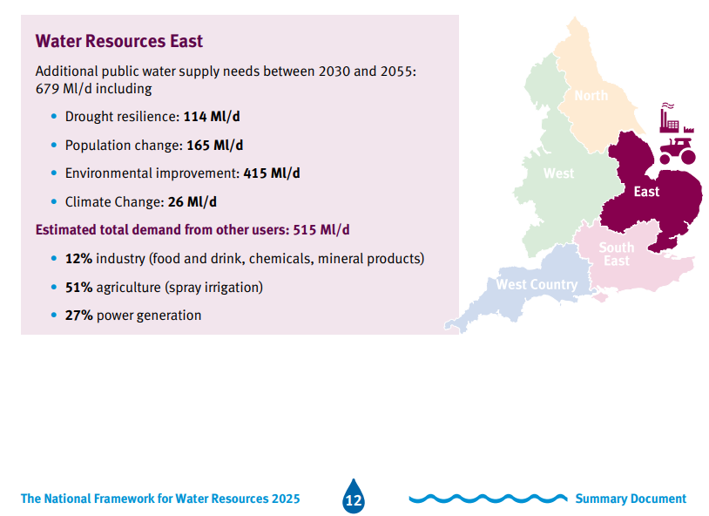
National and Regional Water Deficits

Slide 13
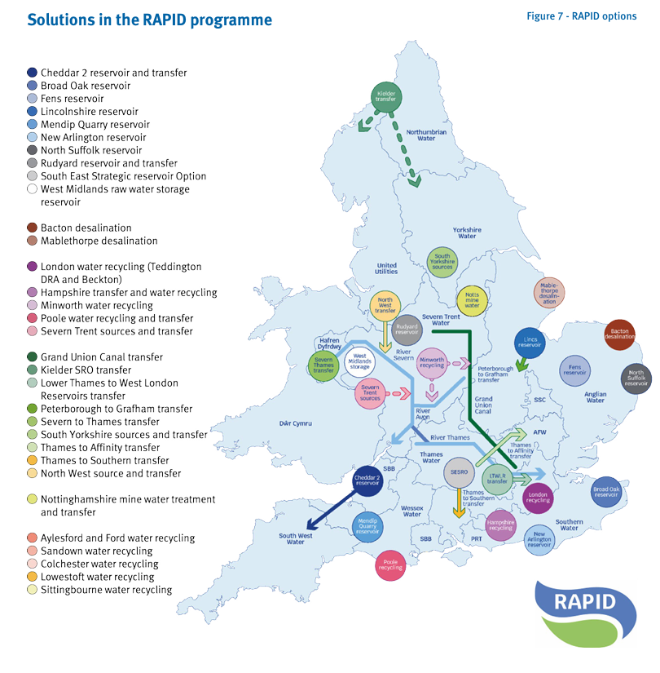
RAPID and Strategic Resource Options (SROs)
Range of water resource options needed
RAPID (Regulators’ Alliance for Progressing Infrastructure Development) gated process for development of Strategic Resource Options > 2800 Ml/d being assessed
“Needs to be greater join-up of options between sectors of use, particularly the water industry and the energy sector”
Demand management needed before SROs come online

Slide 14
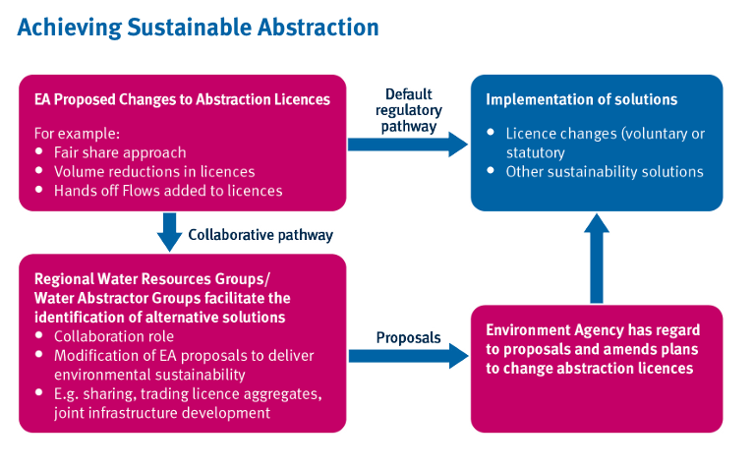
National Framework for Water Resources 2025:
Achieving Sustainable Abstraction

Slide 15
Section 7 :Taking Action on Water for Energy
The report recognises that water is vital for use in the production of energy, and energy is vital to support growth and economic security.
Expect to see demand for low carbon energy generation increase significantly from all sectors over the coming decades with an associated increased demand for water
Work carried out for the Environment Agency estimates that the water needs for Carbon Capture and Storage and hydrogen production alone will amount to 767 Ml/d by 2050
Engagement with the sector has demonstrated that there is a need for a better understanding of where water is available so that it is not a barrier to progression.
Recommendations for the Energy sector :
continue to engage with regional water resources planning groups and water companies on the sector’s water needs
identify and evaluate suitable options to meet future water demand, e.g. recycling, desalination
where relevant, develop joint proposals for additional resources in conjunction with other sectors e.g. build green hydrogen near WatCo desalination plant, co-fund plant & share water
improve its long-term planning for expected future water needs
take account of water needs & availability in the design and siting of plants
continue to improve its water efficiency in production methods

Slide 16
Environment Agency Enabling collaborative planning Project
Policy and Regulation barriers
Lack of best value planning framework for water and energy collectively as this has been limited to the appraisal of public water supply deficits and there is no equivalent planning framework that currently interfaces with the regional or water company water resources planning process.
Uncertainty in future abstraction licence availability and allocation mechanism due to constraints in water availability to comply with environmental objectives and legislation.
Lack of clear role definitions and remits in government and regulators which can lead to delays, indecision and uncertainty. The energy sector and water sector, in the round, are unclear as to who should be leading on this issue.
Lack of incentive to engage on water availability before submission on energy planning application stage and competition law restricting the ability for the energy sector to share proposals before they are in the public domain increase the difficulty in planning for water resource needs.
Highly dynamic, evolving new energy technology areas with funding and water use uncertainty meaning that potential water needs are uncertain.
Organisational barriers
Depth of cross sector engagement and shared understanding (data and communication) resulting in a lack of engagement and a shared understanding of key issues.
Dynamic and variable nature of the energy sector resulting in piecemeal engagement and further challenges in moving from a centralised to decentralised system..
Dynamic and variable nature of the energy sector resulting in piecemeal engagement and further challenges in moving from a centralised to decentralised system
The project was designed to identify existing opportunities and future potential routes to join up planning to meet the water needs of the energy sector, and to provide realistic options and recommendations of how to overcome these barriers
Technical barriers
Competing strategic water demands to reconcile which could become a more significant issue over time as demands for water increase.
Lack of suitable locational or catchment level forecasts for energy production which does not provide the sufficient detail needed to inform water planning at a spatial scale.
Lack of visibility of water company constraints and potential costs (options) to supply water resulting in a lack of spatial steers early in the planning process.
Financial barriers
Competition prohibiting transparency of energy sector plans disincentivises energy companies from sharing potential site or regional energy development locations and limits the development of spatially specific forecasts of future energy water use.

Slide 17
Independent Water Commission Report
Final Report published 21 July 25
Sir Jon Cunliffe
Cunliffe Report

Slide 18
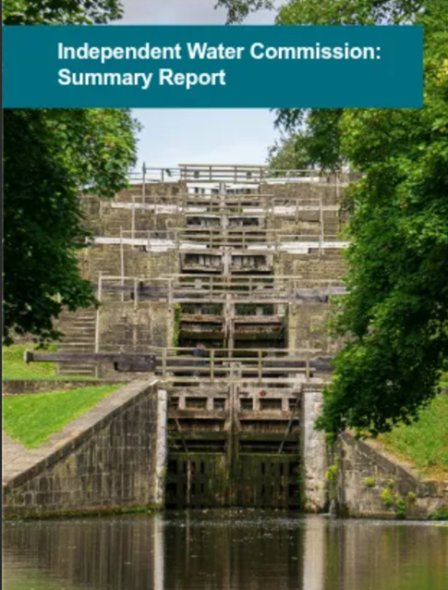
Key Recommendations (88 in Total)
1. Strategic Direction
Introduce a National Water Strategy for England and Wales.
Replace fragmented guidance with a cross-sectoral, long-term framework.
Establish a Ministerial Statement of Water Industry Priorities (MSWIP).
2. Planning Reform
Create regional systems planners in England and a national planner in Wales.
Consolidate 9 existing water company plans into 2 core frameworks: Water Environment and Water Supply.
Adopt a 5/10/25-year investment model to replace rigid 5-year delivery cycles.
3. Legislative Reform
Review and rationalise over 100 pieces of water legislation.
Update the Water Framework Directive (WFD) and Urban Wastewater Treatment Regulations (UWWTR).
Introduce a new statutory target for water body health and integrate public health outcomes.
5. Infrastructure & Resilience
Develop statutory resilience standards for infrastructure and supply chains.
Improve asset mapping, delivery assurance, and security legislation.
Expand Direct Procurement for Customers (DPC) and streamline planning processes.
6. Governance & Ownership
Strengthen regulatory powers over ownership and governance.
Introduce a senior accountability regime and public benefit clauses in licenses.
Improve financial resilience and investor confidence.
7. Innovation & Technology
Introduce regulatory sandboxes and review innovation funding mechanisms.
Encourage collaboration with academia and industry.
Disseminate innovation learnings across the sector.

Slide 19
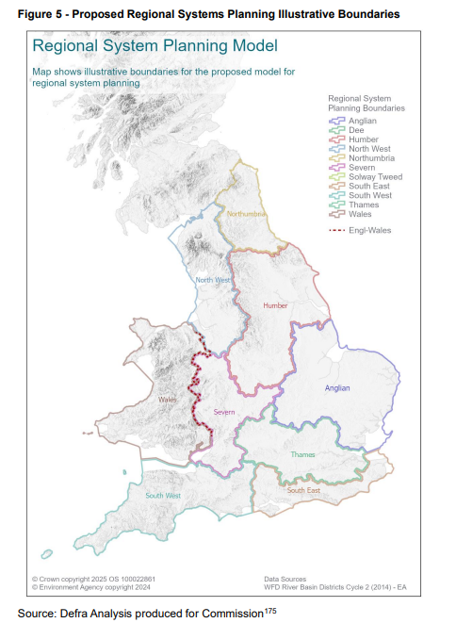
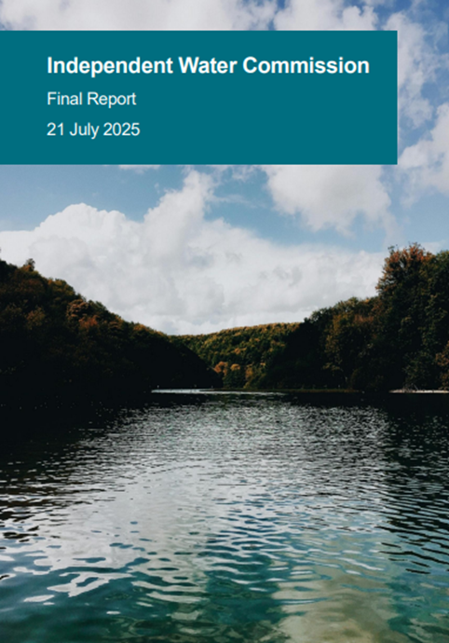
Proposed Regional System Planning Model
Recommendation 3: A comprehensive systems planning framework should be introduced for England and Wales, with responsibility for integrated and holistic water system planning. In England, the systems planners should be regional – or ‘regional water authorities’. In Wales, the systems planner should be a national authority.
This recommendation outlines the systems planners’: • functions
• geographic scale
• responsibilities for convening and consultation
• levers to drive action by other sectors
• national coordination arrangements
• composition – for instance, their chairs, strategic boards
• organisational independence

Slide 20
Links
National Framework for Water Resources 2025: water for growth, nature and a resilient future - GOV.UK
Summary NFWR 2025, including asks for energy sector
Environment Agency Water Hub | Engage Environment Agency
Environmental Destination - Get involved! | Engage Environment Agency
Environmental Destination Technical Report
Catchment Summaries for Environmental Destination
Modelled Abstraction Reductions - National Framework for Water Resources 2025
link to download spreadsheet
Independent Water Commission Final Report
Independent Water Commission: review of the water sector - GOV.UK

Slide 21
Discussion: 2026 Permitting & Planning Priorities
All

Slide 22
Updated Priority Work Areas
Streamlining Permitting
EALs
Cumulative Impacts
Novel Technologies
Monitoring & Measurement
Lessons Learned
EPR Reform
Solvent Disclosure
Awaiting response
EA report published
Published
Ongoing
Ongoing NPL project
New!
Streamlining Planning
National Policy Statements
CCUS National Policy Statement
Cross-border Barriers
Devolved Nation Barriers
Planning & Infrastructure Bill
Ongoing
Published
Ongoing
Ongoing
Not started
Awaiting royal ascent
Notes:
Priorities were set in May last year so this is progress achieved since May
Some of these are CCSA workstreams while others are government or regulator-led work

Slide 23

AOB & Conclusions
Review actions arising from the meeting.
Next Meeting: TBC – a calendar placeholder will be circulated in due course
AOB
© CCSA Confidential information |
23

